Slide 1
Library Management System
Presented By:
K . Mahendra
M . Vamsi
J . Rakesh
Y . Akash

Slide 2
Introduction
The Library Management System is a desktop application designed to manage library records efficiently. It helps organizations store, retrieve, update, and delete library information electronically.
The system replaces manual record-keeping and improves accuracy, security, and accessibility of library data.
This application is developed using:
Java (Core Java)
JDBC(Java Database Connectivity)
MySQl

Slide 3
Problem Statement
In many organizations, library information is maintained manually using paper records or spreadsheets. This leads to:
Data redundancy
Difficulty in searching records
Time-consuming updates
Risk of data loss
Therefore, there is a need for an automated system to manage books records efficiently.

Slide 4
Objectives
The main objectives of the project are:
To store library books information in a database
To add new books
To update/ delete existing admin details.
To delete or edit existing books
To display books information in an easy-to-use interface
To add new staff
To delete/ edit existing staff details

Slide 5
Scope of the project
The system can be used in:
Universities
Colleges
Schools
Private Libraries
The system will allow authorized admin / user to manage library information through a desktop application.

Slide 6
Modules Description
The Library Management system consists following Modules:
Admin Management Module
This module manages admin information in the database. It allows the admin to login into his account and can access details of library books, staff . It allows admin to add new books, edit and remove existing books. It performs database operations such as insert, update, delete, and select.
2. Books Management Module
This module manages books information available in library. It stores every books by a ID. It allows user to add new books, delete and edit existing books.

Slide 7
Modules Description
3. Staff Management Module
This module manages all staff members details. I allows admin to add new staff, remove and delete existing staff details.
4. Search Module
This module allows the user to search for books information using Book ID or Author Name or Book Name. It retrieves the required book details from the database and displays them to the user/admin.

Slide 8
Modules Description
5 Database Connectivity Module
This module connects the application to the MySQL database using My SQL Connector. It is responsible for establishing database connection, executing SQL queries, retrieving data, and closing the connection.
6. User Interface Module
This module provides the graphical user interface console based. It allows the user to interact with the system by entering admin details, performing operations, and viewing results.

Slide 9
Module Description
7. Display Module
This module displays books , staff and admin information in a structured format, usually in a table. It retrieves data from the database and presents it clearly for easy understanding

Slide 10
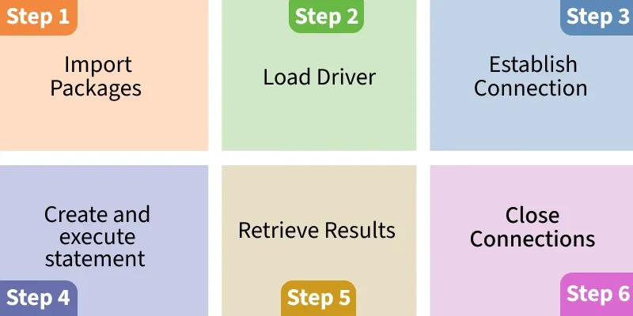
Database connectivity

Slide 11
DATABASE CONNECTIVITY
import java.sql.*;
class Geeks {
public static void main(String[] args) throws Exception {
String url = "jdbc:mysql://localhost:3306/database_name"; // Database details
String username = "rootgfg"; // MySQL credentials
String password = "gfg123";
String query = "select * from students"; // Query to be run
// Load and register the driver
Class.forName("com.mysql.cj.jdbc.Driver");
// Establish connection
Connection con = DriverManager.getConnection(url, username, password);
System.out.println("Connection Established successfully");
// Create a statement
Statement st = con.createStatement();
// Execute the query
ResultSet rs = st.executeQuery(query);
// Process the results
while (rs.next()) {
String name = rs.getString("name"); // Retrieve name from db
System.out.println(name); // Print result on console
}
// Close the statement and connection
st.close();
con.close();
System.out.println("Connection Closed....");
}
}

Slide 12
Database Design
Database design is the process of organizing data into tables, defining relationships between tables, and specifying constraints to ensure data integrity and efficiency. The Library Management System uses a relational database to store and manage admin, books and staff information.
The database is designed using the Relational Database Model and implemented using MySQL Database.
The main objective of database design is to:
Store book information efficiently
Avoid data redundancy
Maintain data integrity
Provide fast access to books

Slide 13
Database Design
Based on system requirements, the following entities are identified:
Admin
Books
Staff
Each entity is represented as a table in the database.

Slide 14
Database Design
Column Name | Data Type | Description | Constraint
USER_ID | INTEGER | Unique user ID | Primary Key
NAME | VARCHAR(50) | Name of Admin | Null
PASSWORD | VARCHAR(50) | Password of that admin | Null
CONTACT | VARCHAR(10) | Contact of admin | Null

Slide 15
Database Design
The Book table stores information about books available in library.
Column Name | Data Type | Description | Constraint
BOOK_ID | INT | Unique book ID | Primary Key
CATEGORY | VARCHAR(50) | Category of book | Null
NAME | VARCHAR(50) | Book name | Null
AUTHOR | VARCHAR(50) | Author name | Null
COPIES | INT | Number of copies available | Null

Slide 16
Database Design
The Staff table stores information about staff member details in library
Primary key: STAFF_ID
Column Name | Data Type | Description | Constraint
STAFF_ID | VARCHAR(50) | Unique staff ID | Primary Key
NAME | VARCHAR(50) | Name of staff | Null
CONTACT | VARCHAR(50) | Contact of staff | Null

Slide 17
SQL Commands
Create Admin Table:
CREATE TABLE admin (USER_ID INT PRIMARY KEY,
NAME VARCHAR(50),
PASSWORD VARCHAR(50),
CONTACT VARCHAR(10),
);
Create Books Table:
CREATE TABLE books (BOOK_ID INT PRIMARY KEY,
CATEGORY VARCHAR(50),
NAME VARCHAR(50),AUTHOR VARCHAR(50),COPIES INT);

Slide 18
SQL Commands
Create staff Table:
CREATE TABLE staff (STAFF _ID VARCHAR(50) PRIMARY KEY,
NAME VARCHAR(50),
CONTACT VARCHAR(10));

Slide 19
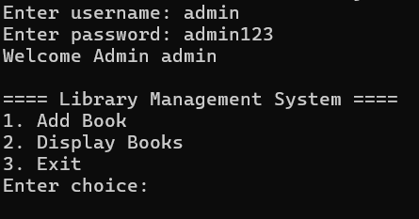
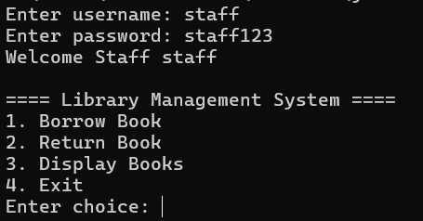
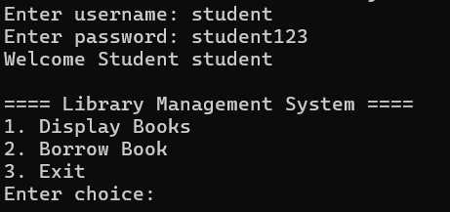
User Interface
It shows the interface of Library management which contains we can login admin , staff , student with username and password. For Invalid username or password it returns Invalid try again…

Slide 20
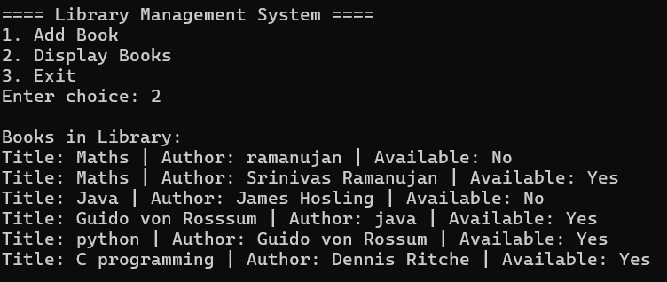
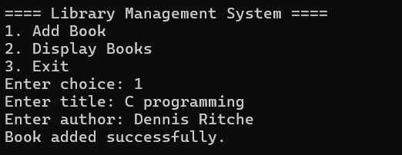
User Interface
Admin Module:
It contains add books ,display books and exit options. Add books is used to add books by admin , display books is used to display books in it.

Slide 21
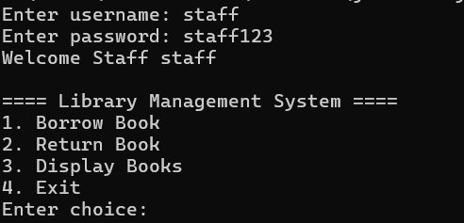
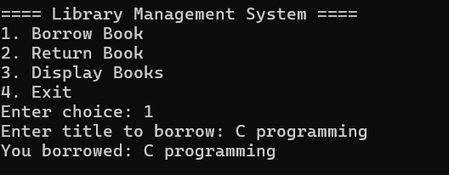
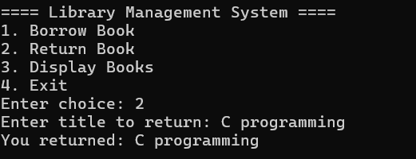
User Interface
Staff Module:
These module is used to manage books in the library for borrow , return and display books. It is used to track the books that staff had borrowed.

Slide 22
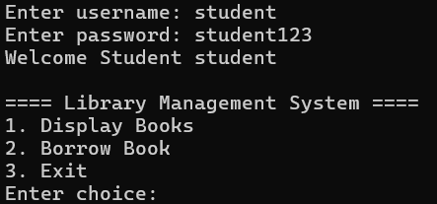
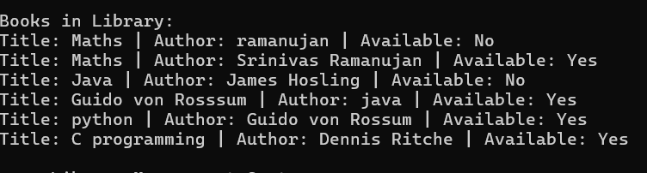
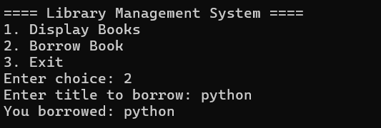
User Interface
Student module:
These module is used to borrow the books from the library as per books available.

